Slide 1
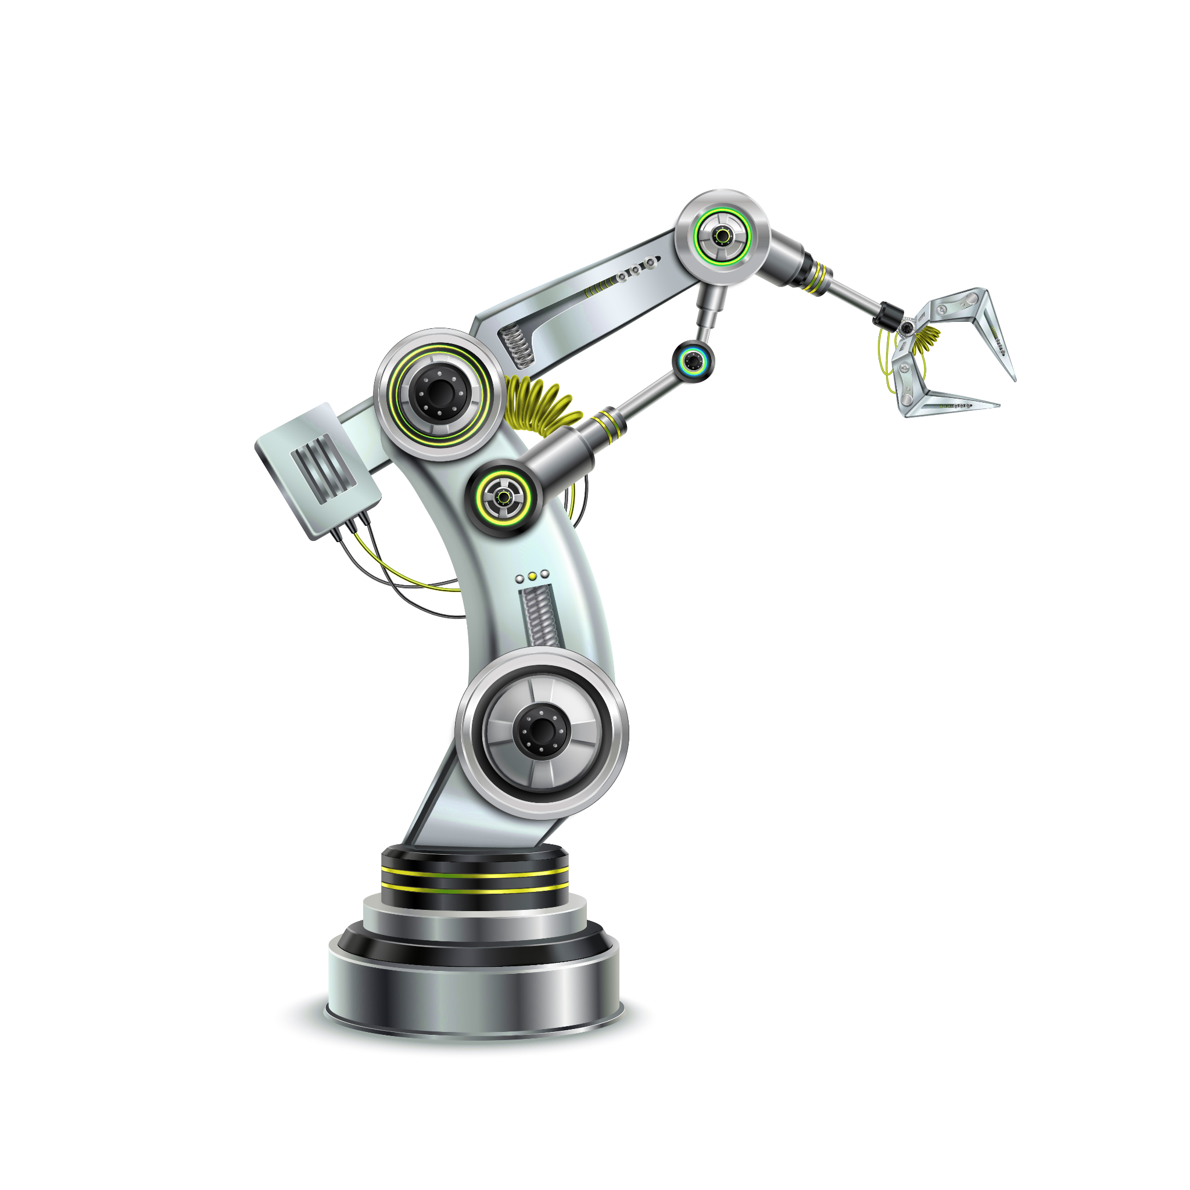
Kinematic and Dynamic Analysis of
6 DOF
manipulator with Trajectory Planning
MAE 547 Modeling and Control of Robots
Aditi Babasaheb Pawar

Slide 2

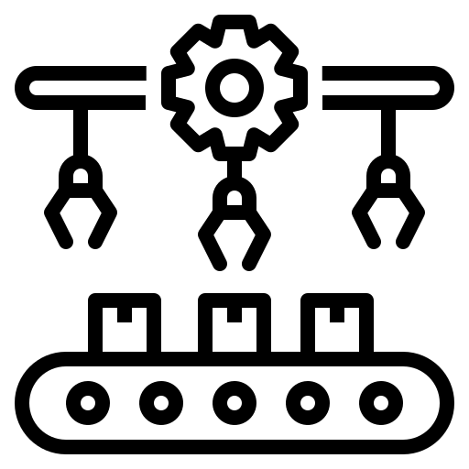


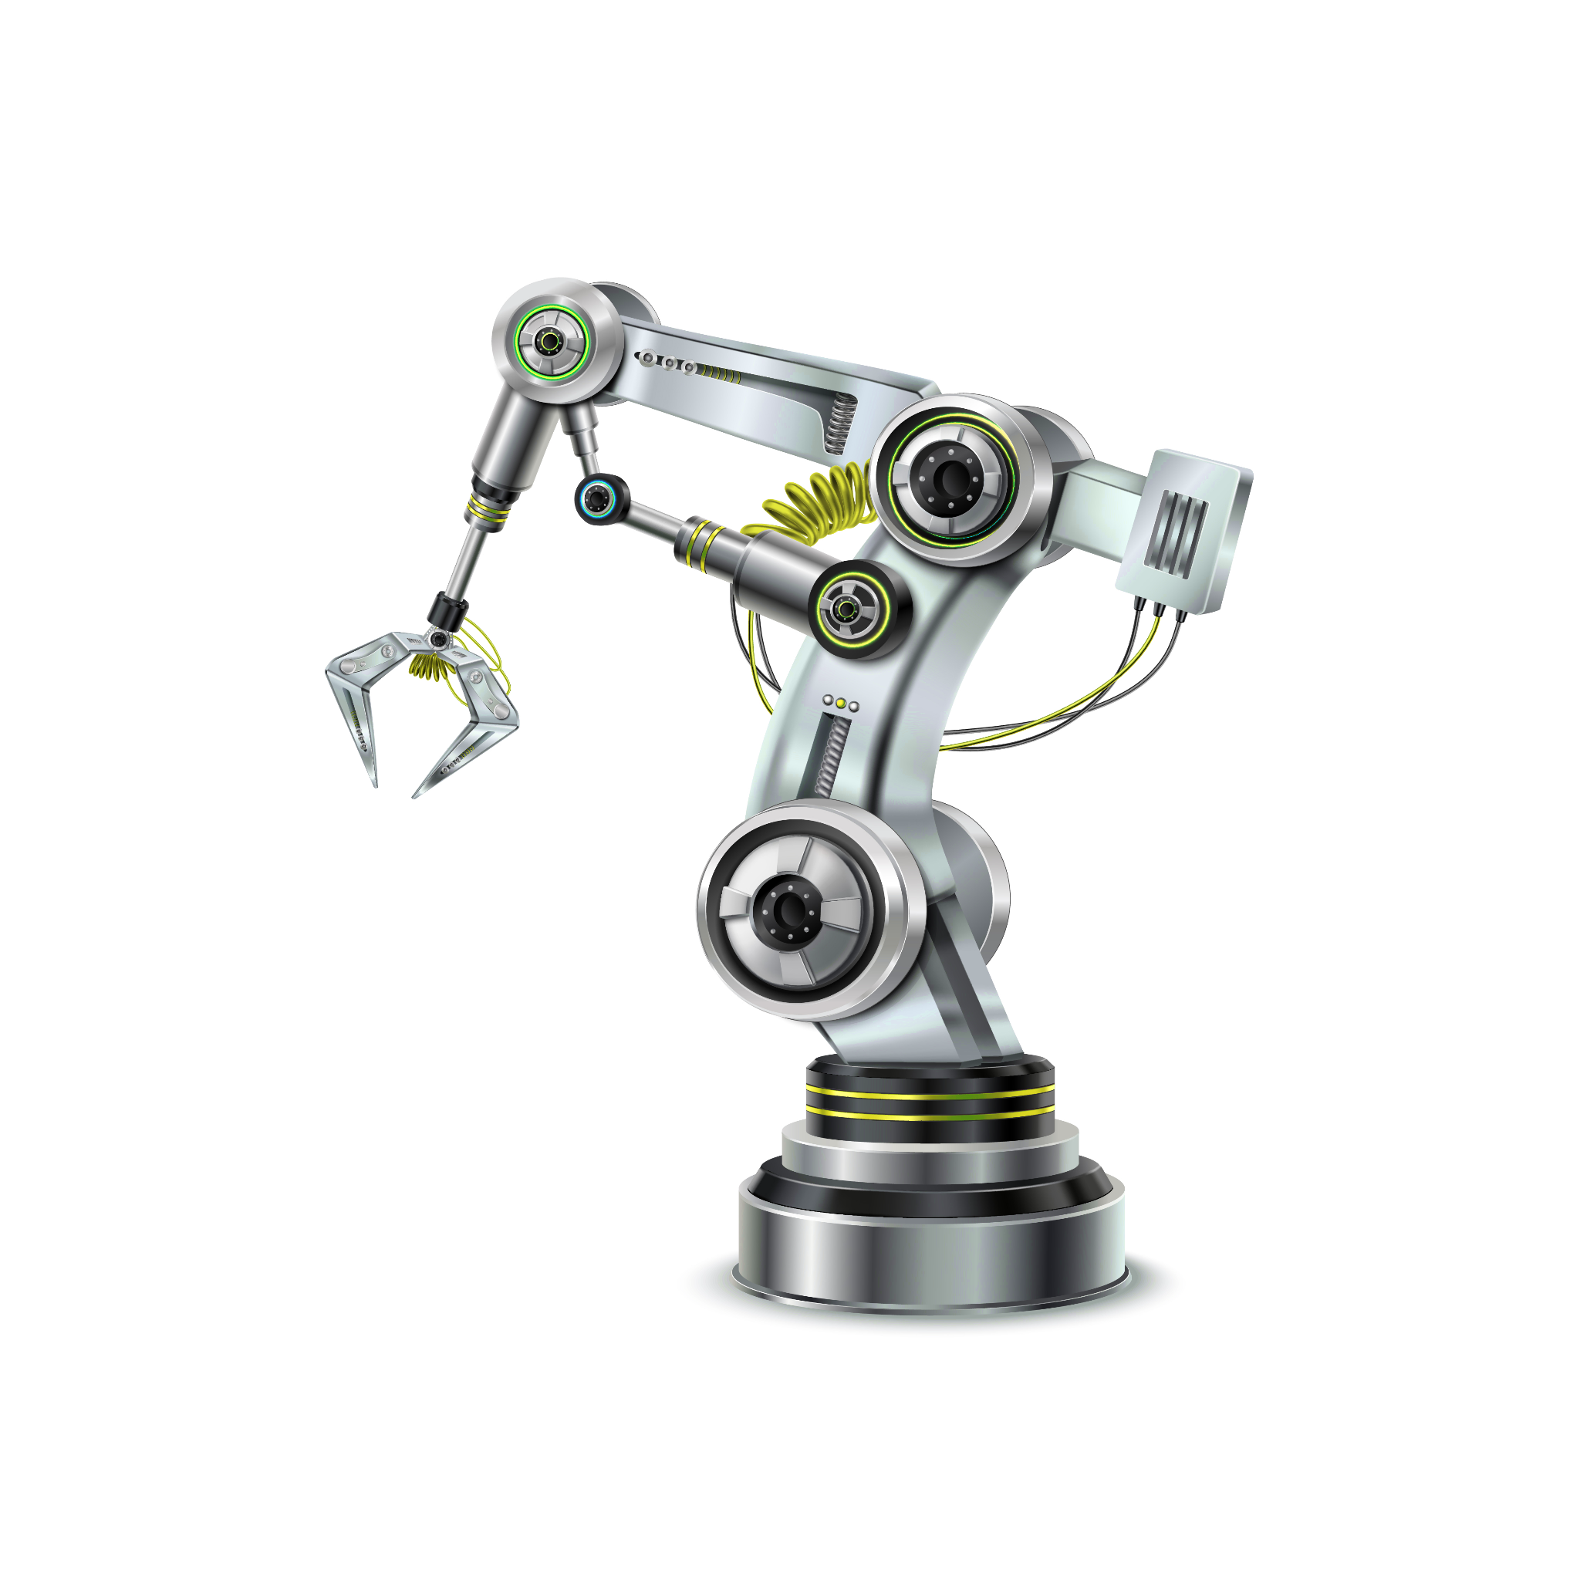
Introduction
A Manipulator is a Robotic arm that is used to carry out tasks. The tasks can be pre-defined or can be carried out by an operator.
The necessity of robotic arm increased nowadays in industries due to their speed, efficiency and accuracy in high-speed manufacturing. It is programmed in such a way that it completes its designated tasks.
According to the application, the end effector can be chosen and also the Degree of Freedom DOF of the manipulator is determined.
The manipulator considered here is a 6DOF robot with all six revolute joints.

Slide 3
Problem Statement
Model of a 6 DOF robotic arm by performing it’s Kinematic and Dynamic Analysis.
And implement Trajectory generation to execute it’s trajectory planning for joint space and task space for
I. Rotation
II. Without Rotation
And carry out their comparative studies.
}
For these time scale:
Trapezoidal
Quintic
Cubic

Slide 4
Approach
STEP 1
STEP 2
STEP 3
STEP 4
STEP 5
To assign the coordinate axis to the robot model to get the DH parameter. The parameter obtained will then be used to calculate the forward and inverse kinematics of the robotic manipulator by calculating the homogeneous transformation matrix of end effector
The joint limits of robotic arms were added into the model using ‘Position Limits’ instance of rigid Body Joint class. The Dynamic Properties like mass, Center of Mass and Inertial properties of the link are fed to the model.
Plotting the graphs in 2D plane to study the change in the angles of the respective joints with respect to time to differentiate the joint and space task at that specific time.
Obtaining results for joint space and task space trajectory for 3 different time scales- i.e. Trapezoidal, Quintic and Cubic and compare its velocities and accelerations.
Comparing these trajectories with rotation and no rotation mechanics. Plotting these trajectories on the 3D cartesian plane to examine its speed and transition to the next position.

Slide 5
Modelling of 6 DOF robotic arm
Idx | Body Type | Joint Name | Joint Type | Range (deg)
1 | L1 | J1 | revolute | [-170,170]
2 | L2 | J2 | revolute | [-65 140]
3 | L3 | J3 | revolute | [-180, 70]
4 | L4 | J4 | revolute | [-300, 300]
5 | L5 | J5 | revolute | [-130 130]
6 | L6 | J6 | revolute | [-300 300]
7 | Gripper | J7 | fixed
Model was created using ‘rigidBodyTree’ class
It was used to represent the connectivity of rigid bodies with joints
It is made sure that the MATLAB model accepts modified DH parameters
The dynamic properties like mass, centre of mass and inertial properties of the link are fed to the model.
For visual purposes STL files of links were added using ‘addVisual()’ function.

Slide 6
Forward Kinematics
DH Table
 | a(m) | ⍺ (rad) | d(m) | θ(rad)
0-1 | 0 | 0 | 0.680 | θ₁
1-2 | 0.320 | π/2 | 0 | θ₂
2-3 | 0.975 | 0 | 0 | θ₃
3-4 | 0.200 | π/2 | 0.887 | θ₄
4-5 | 0 | -π/2 | 0 | θ₅
5-6 | 0 | π/2 | 0 | θ₆
6-7 | 0 | 0 | 0.200 | θ₇
Link length a_{i} | ‘a_{i}’ is the distance from the origin of frame 0 and the origin of frame 1
Link Twist ⍺_{i} | ‘α_{i}’ is the angle from z₀ to z₁ around x₁ axis.
Link Offset d_{i} | ‘d_{i}’ is the distance from x₀ to x₁ along the z₀ direction
Joint Offset θ_{i} | ‘θ_{i}‘ is the angle from x₀ to x₁ around z₀ axis.

Slide 7
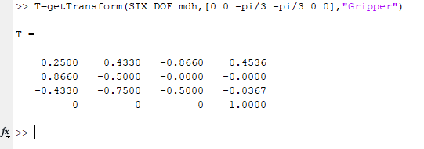
Forward Kinematics
A homogeneous transformation matrix is constructed to define frame (i) w.r.t to frame (i-1)
₇⁰𝑇=₀¹𝑇×₂¹𝑇×₃²𝑇×₄³𝑇×₅⁴𝑇×₆⁵𝑇×₇⁶𝑇
The transformation matrix can be calculated either by hand or using Matlab. In order to get the homogeneous transformation matrix in Matlab, getTransform() function is used. The below is the image of the code for finding transformation matrix.

Slide 8

Inverse Kinematics
Inverse Kinematics analysis is finding the joint angles given a particular pose of the end effector. Both analytical as well as simulation software approaches are used.
[⁰₁𝑇] ⁻¹ ⁰₇𝑇= ¹₂𝑇²₂𝑇³₄𝑇⁴₅𝑇⁵₆𝑇⁶₇𝑇
Θ₁= 𝐴𝑡𝑎𝑛2(𝑝_{𝑦}, 𝑝_{𝑥})
Θ₃= = 𝐴𝑡𝑎𝑛2(𝑎₃, 𝑑₃ + 𝑑₇ ) − 𝐴𝑡𝑎𝑛2(±𝐾, √(𝑎₃ ² + (𝑑₃ + 𝑑₇)² − 𝐾²)
Where,
K =𝐾 = (𝑝_{𝑥}𝑐₁ + 𝑝_{𝑦}𝑠₁ − 𝑎₁) 2 + (𝑝_{𝑧} − 𝑑₁) ² − 𝑎₂ ² − 𝑎₃ ² − (𝑑₃ + 𝑑₇) ²
²𝑎₂
To perform Inverse Kinematics in MATLAB two functions can be used, ‘inverseKinematics()’ and generalizedInverseKinematics().
‘generalizedInverseKinematics()’ is used when there are more constraints apart from pose of the end effector.

Slide 9
Static velocity calculation
As a robotic manipulator is a chain of bodies, each one is capable of moving in its axis relative to the neighboring one. Velocity of link i+1 will be addition of velocity of link i and velocity component added by joint i+1. While determining the motion of robot links, link frame 0 is taken as reference.
The angular velocity of link i+1 with respect to frame i+1 for revolute joint is
^{𝑖+1}_{𝑖+1}𝜔= ^{𝑖+1}_{𝑖}R ^{𝑖}_{𝑖}𝜔 + 𝜃̇_{𝑖+1}^{𝑖+1}_{𝑖+1}𝑍̂
The linear velocity of link i+1 with respect to frame i+1 for revolute joint is
^{𝑖+1}_{𝑖+1}𝑣= ^{𝑖+1}_{𝑖}R (^{𝑖}_{𝑖}𝑣 + ^{𝑖}_{𝑖}𝜔 × ^{𝑖}_{𝑖+1}P)
For simplicity in the calculation, linear and angular velocity are calculated at [0 pi/2 0 0 0 0] joint values. The angular and linear velocity of the base frame are zero.

Slide 10
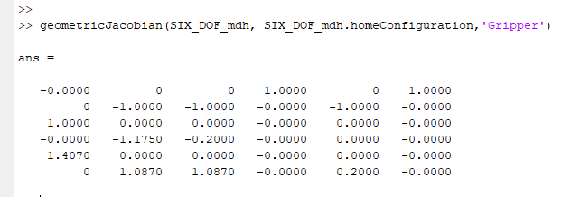
Static velocity calculation
The Jacobian matrix is computed with respect to the base frame. geometricJacobian() function is used to calculate the Jacobian Matrix of the 6 DOF robotic arm
From the above image, the bottom right 4 and 6 columns indicate that motion of Joint 4 and Joint 6 does not have any translational effect on the end effector.
𝜃̇=𝐽⁷(𝜃)⁻¹𝑉⁷
The joint rates can be calculated only if the Jacobian Matrix is non-singular. Joint Values 𝜃 at which Jacobian Matrix becomes singular are known as singularities. Singularity is achieved when two robot links align in the same orientation, resulting in a reduction in the DOF

Slide 11
Trajectory Generation
The velocity and acceleration along the trajectory are defined as-
𝜃̇=(𝑑𝜃/𝑑𝑠)𝑠̇ 𝜃̈=(𝑑𝜃/𝑑𝑠)𝑠̈+(𝑑²𝜃/𝑑𝑠²)𝑠̇²
Cubic order polynomial
In cubic order polynomial, the time scaling 𝑠(𝑡) is given by-
𝑠(𝑡)=𝑎₀+𝑎₁𝑡+𝑎₂𝑡²+𝑎₃𝑡³+𝑎₄𝑡⁴+𝑎₅𝑡⁵
For initial conditions: 𝑠(0)=0 ; 𝑠(𝑇)=1; 𝑠̇(0)=𝑠̇(𝑇)=0
𝑠(𝑡)= (3/𝑇²) 𝑡² − (2/𝑇³) 𝑡³
Quintic Time Scaling
In cubic order polynomial, the time scaling 𝑠(𝑡) is given by-
𝑠(𝑡)=𝑎₀+𝑎₁𝑡+𝑎₂𝑡²+𝑎₃𝑡³+𝑎₄𝑡⁴+𝑎₅𝑡⁵
For initial conditions: 𝑠(0)=0 ; 𝑠(𝑇)=1; 𝑠̇(0)=𝑠̇(𝑇)=0 ; 𝑠̈(0)=𝑠̈(𝑇)=0
𝑠(𝑡)= (10/𝑇³) 𝑡³ − (15/𝑇⁴)𝑡⁴ + (6/𝑇⁵) 𝑡⁵
Trapezoidal Time Scaling
This time scaling is widely used in motion control. It consists of a constant acceleration phase 𝑠̈=𝑎 for a time period 𝑡𝑎. Largest velocity and acceleration in trapezoidal time scaling down below:
|(𝜃_{𝑒𝑛𝑑}−𝜃_{𝑠𝑡𝑎𝑟𝑡})𝑣|=𝜃̇ |(𝜃_{𝑒𝑛𝑑}−𝜃_{𝑠𝑡𝑎𝑟𝑡})𝑎|=𝜃̈
For a three-stage trapezoidal profile, 𝑣2𝑎≤1 must be satisfied.
𝑇=(𝑎+𝑣²)/𝑣𝑎

Slide 12
Comparison of joint and task space
Joint Space Trajectory
Cubic Scaling
𝜃̇𝑚𝑎𝑥 = 3 (𝜃_{𝑒𝑛𝑑}− 𝜃_{𝑠𝑡𝑎𝑟𝑡}) / 2𝑇
𝑇𝑚𝑎𝑥 ≥ 0.8612
Quintic Scaling
𝜃̇𝑚𝑎𝑥 = 15 (𝜃_{𝑒𝑛𝑑}− 𝜃_{𝑠𝑡𝑎𝑟𝑡}) / 8𝑇
𝑇𝑚𝑎𝑥 ≥ 1.0765
Trapezoidal Scaling
Using, (𝑣²/𝑎) ≤ 1 we get 𝑇 ≤ 2/𝑣
Task Space Trajectory
Cubic Scaling
𝑝̇_{𝑚𝑎𝑥} = 3 (𝑝_{𝑒𝑛𝑑}− 𝑝_{𝑠𝑡𝑎𝑟𝑡}) / 2𝑇
𝑇𝑚𝑎𝑥 ≥ 0.307
Quintic Scaling
𝑝̇_{𝑚𝑎𝑥} = 15 (𝑝_{𝑒𝑛𝑑}−𝑝_{𝑠𝑡𝑎𝑟𝑡}) / 8𝑇
𝑇𝑚𝑎𝑥 ≥ 0.383
Trapezoidal Scaling
Using, (𝑣²/𝑎) ≤ 1 we get 𝑇 ≤ 2/𝑣

Slide 13
Descriptions on how to run the code
Open ‘Code’ file: The file named ‘Kinematic_Dynamic Analysis’ contains the necessary .stl files and the Model.m files needs to be stimulated first to mesh the .stl files together and get the SIX.mat file
Step 1
‘Trajectory Planning’ After that navigate back to the code file and select the ‘Trajectory Planning’ file and run the Via_Points.m file.
Step 2
Step 3
‘Task_vs_Joint_Spce_1.m’ To get the graphs for various joint angles at different time frames, which compare Joint and task space, simulate the ‘Task_vs_Joint_Space_1.m’ file
Step 4
‘Trajectory_No_Rotation_2.m’ Run the ‘Trajectory_No_Rotation_2.m’ file to get the final results for no rotation mechanics.
‘Trajectory_with_rotation_3.m Finally run the ‘Trajectory_with_rotation_3.m’ file so as to get the output for robot arm trajectory for the rotation matrix
Step 5
Notes:
These are the steps f

Slide 14

Results
Output 1: Joint space trajectory for no rotation mechanics
https://drive.google.com/file/d/1u5uHNkO-y3sariiPa8yXbMtnsJpdcCrN/view?usp=sharing
Output 2: Task space trajectory for no rotation mechanics
https://drive.google.com/file/d/1CLwho0reaeMLakE083C-v7oqNOTjPp5j/view?usp=sharing

Slide 15
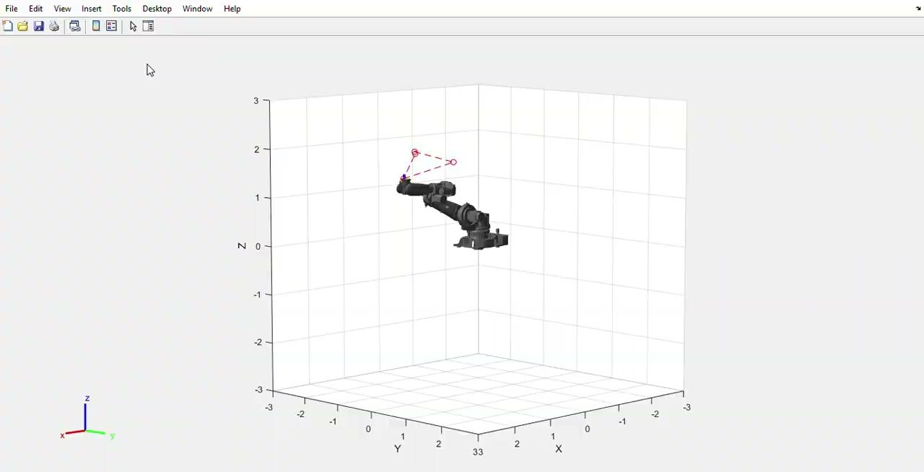
Results
Output 3: Task and joint space trajectory for rotation mechanics
https://drive.google.com/file/d/10Oc7ayzeAgDZtFXQFLfPtYZ3nZeJ1JVT/view?usp=sharing

Slide 16
Conclusion & Discussion
This project is to understand foundation approach for modeling a Robotic Manipulator.
Complete graphical data is provided to ease the transparency of the process and improve the analysis.
Kinematic and dynamic modelling and analysis of a robot is done with supporting graphical and numerical results.
Joint space and Task space trajectories were compared in MATLAB.
Comparing the two cases, each one has its own pros and cons.
Joint space planning method executes faster since Inverse Kinematics is only calculated at the via-points. Also, the actuator motion is smooth and easier to validate. But in joint space, intermediate points are not guaranteed to be collision free or respect joint limits.
In task space planning, Motion is predictable and offers better handling of obstacles and collisions. But the method is slower since Inverse Kinematics is calculated at every time step. Also, the actuator motion is not necessarily smooth.

Slide 17
References
Jamshed Iqbal, Raza ul Islam, and Hamza Khan, ‘Modeling and Analysis of a 6 DOF Robotic Arm Manipulator’,Canadian Journal on Electrical and Electronics Engineering, 6thJuly 2012
Reza Yazdanpanah A, ‘Geometric Jacobians Derivation and Kinematic Singularity Analysis for Smokie Robot Manipulator & the Barrett WAM’ ,5th International Conference on Robotics and Mechatronics (ICROM),2017
https://www.mathworks.com/help/physmod/smlink/index.html
https://petercorke.com/toolboxes/robotics-toolbox/
https://new.abb.com/products/robotics/industrial-robots/irb-6620
https://bjpcjp.github.io/pdfs/robotics/MR_ch09_trajectory_generation.pdf

Slide 18
Thank You!
Please keep this slide for attribution

